Slide 1
CS 777 Group Project: Text Processing & Sentiment Detection- Based Classification
Sumanth Suram, Yi Han, Dawei Yin, Zhihe Tian

Slide 2
Content
Dataset description
Pre-processing methods
Text processing procedures
Tokenization
Stop words
Etc.
Text classification
Sentiment classification
Topic modeling
References

Slide 3
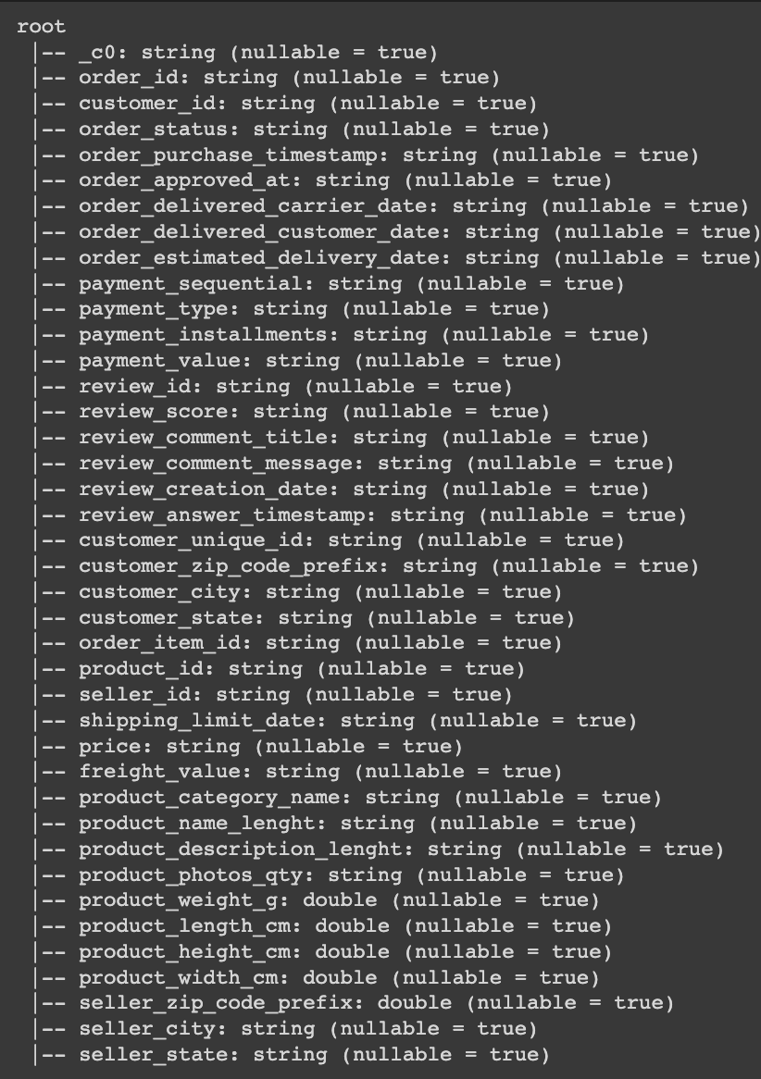
Dataset Description
Our dataset:
A public dataset of ecommerce orders in Brazil that contains:
128k orders from 2016~2018
40 columns in total
Columns are categorized into three main types:
Order
Review
Customer
Product
Seller
Dataset URL: https://www.kaggle.com/datasets/olistbr/brazilian-ecommerce

Slide 4
Dataset Description
Class attribute:
review_score
Input features:
review_comment_message
Input example:
'Não testei o produto ainda, mas ele veio correto e em boas condições. Apenas a caixa que veio bem amassada e danificada, o que ficará chato, pois se trata de um presente.’
Translation:
'I haven't tested the product yet, but it came correct and in good condition. Only the box that came well crumpled and damaged, which will be annoying, as it is a gift.'
Dataset URL: https://www.kaggle.com/datasets/olistbr/brazilian-ecommerce

Slide 5
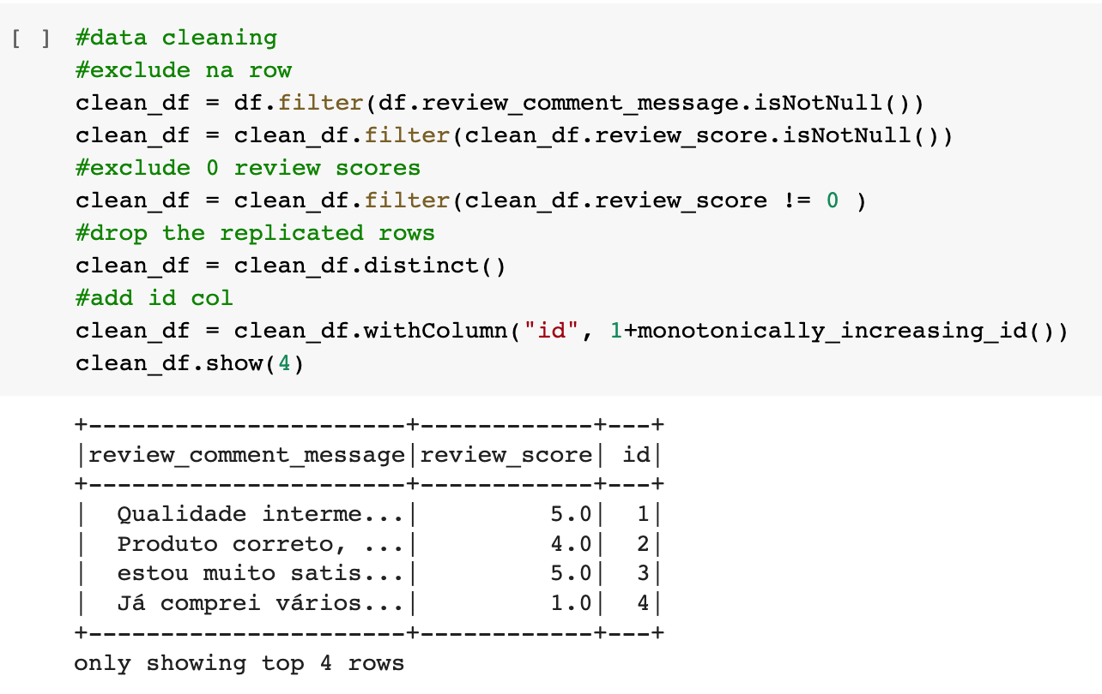
Pre-processing methods
Remove:
NaNs, null values
Data with review scores = 0
Replicated rows
Add:
ID to data
Dataset URL: https://www.kaggle.com/datasets/olistbr/brazilian-ecommerce

Slide 6
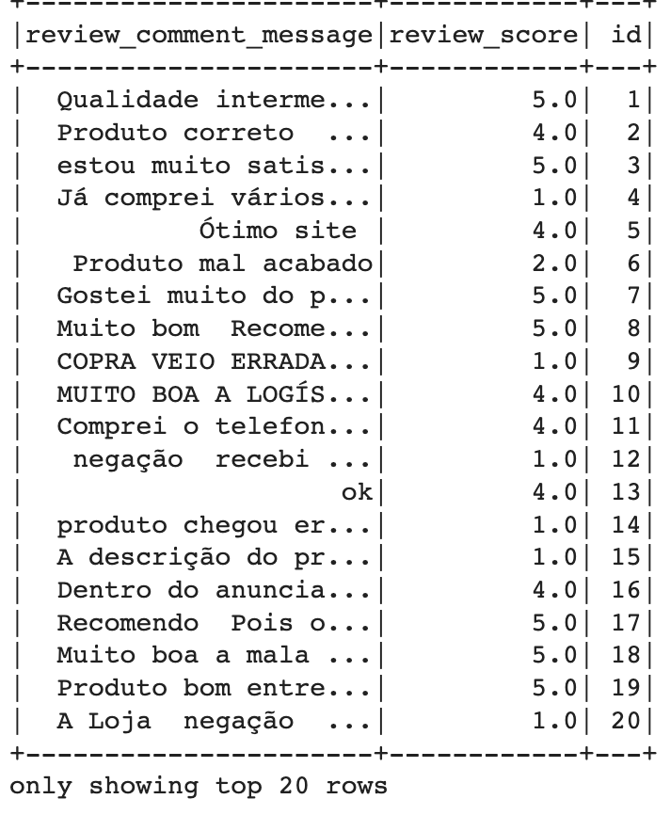
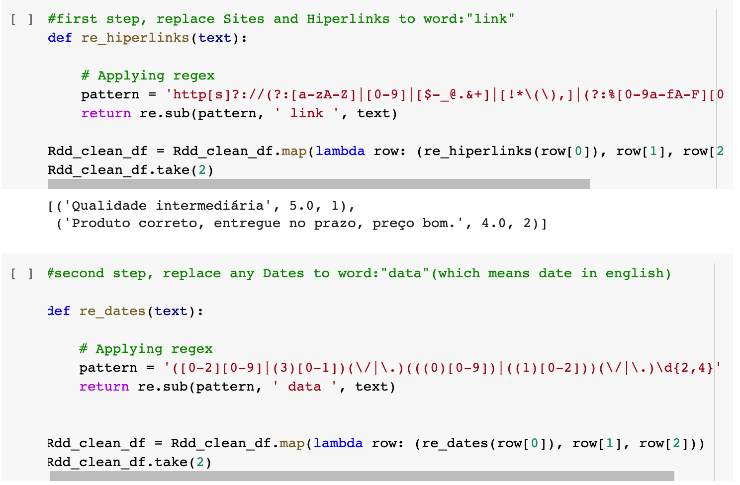
Pre-processing methods
Replace links, dates, currencies, etc. with appropriate values.
Clean dataset

Slide 7
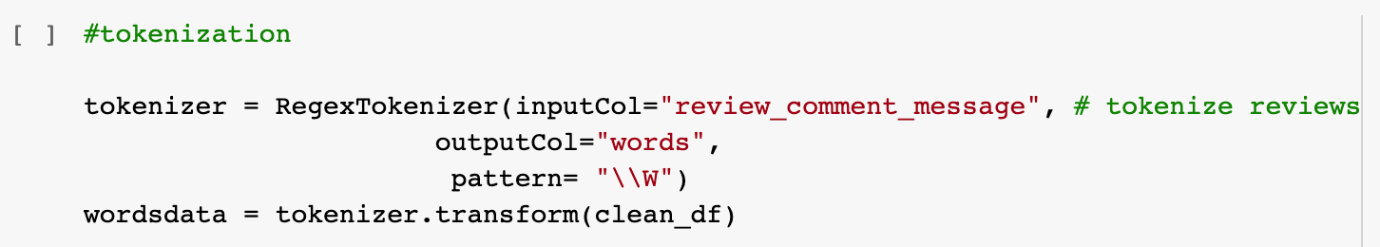
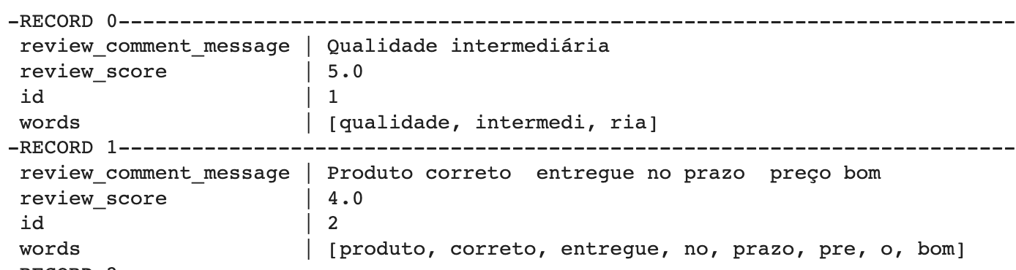
Text processing procedures -Tokenization
Tokenize input column “review_comment_message” into “words” column
Tokenized dataframe
Dataset URL: https://www.kaggle.com/datasets/olistbr/brazilian-ecommerce

Slide 8
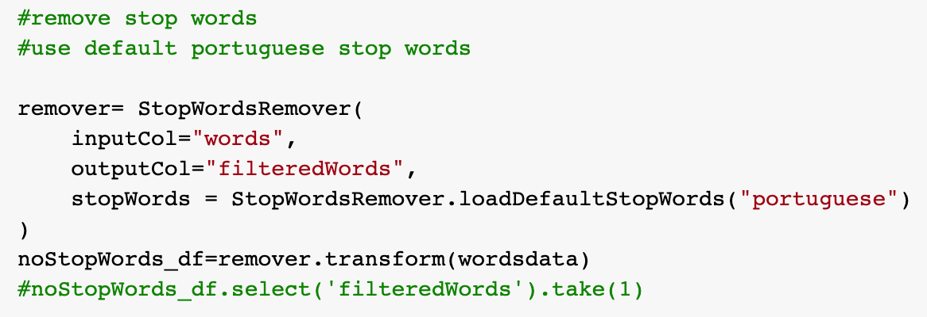
Text processing procedures -Stop words
Rather than using default English stopwords, we are using Portuguese stopwords on our dataset.

Slide 9
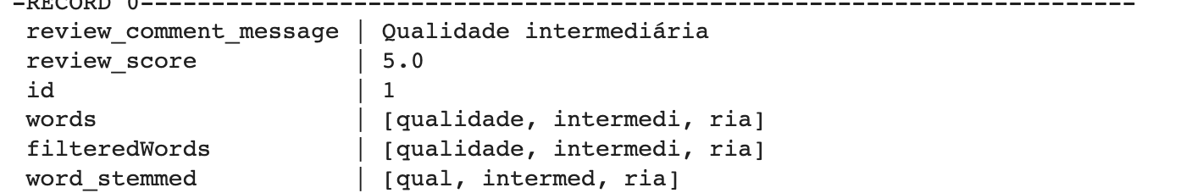
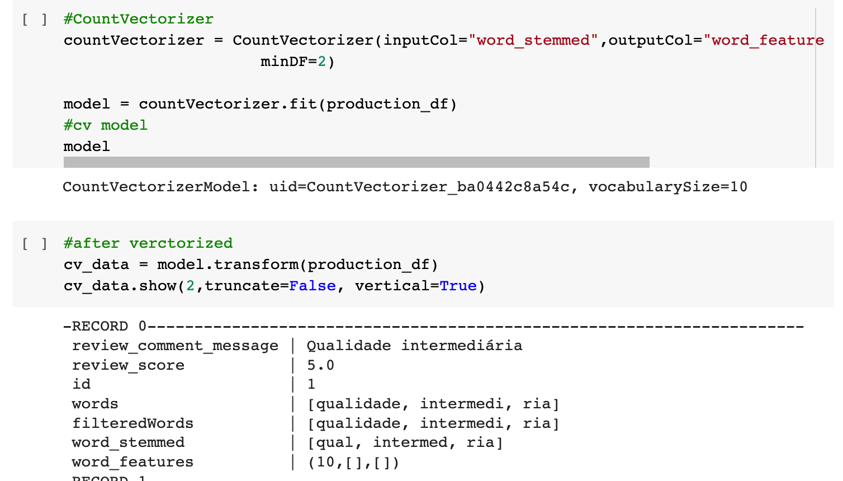
Text processing procedures -Stemming / count vectorizer
Perform text stemming and filter out small or empty vectors
Stemmed dataframe
Create cv model and transform stemmed dataframe

Slide 10
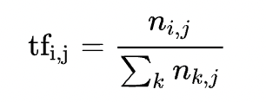
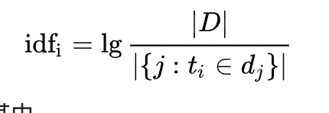

Text processing procedures TF-IDF
To perform topic modeling, we use TF-IDF to determine which words are important to which of our reviews.
First, we will calculate TF (the frequency of each term in a document) with CountVectorizer.
We derive the vocabulary of our data while fitting and get the counts at the transform step.
Then, we proceed with IDF (the inverse frequency of documents where a term occurred), which helps to account for words that are highly frequent in all reviews. This way, these words will not characterize a topic in the topic modelling step. We calculate TF-IDF based on TF results with IDF estimator of PySpark.
+1

Slide 11
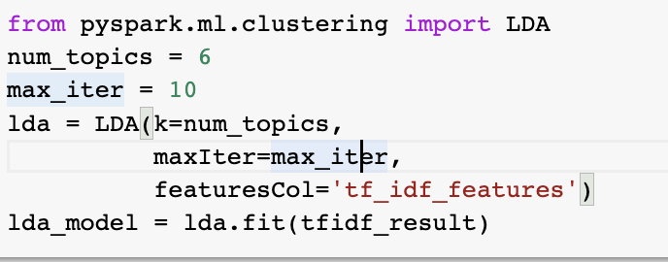
Topic modeling
Extract topic words from the dataset by using LDA

Slide 12
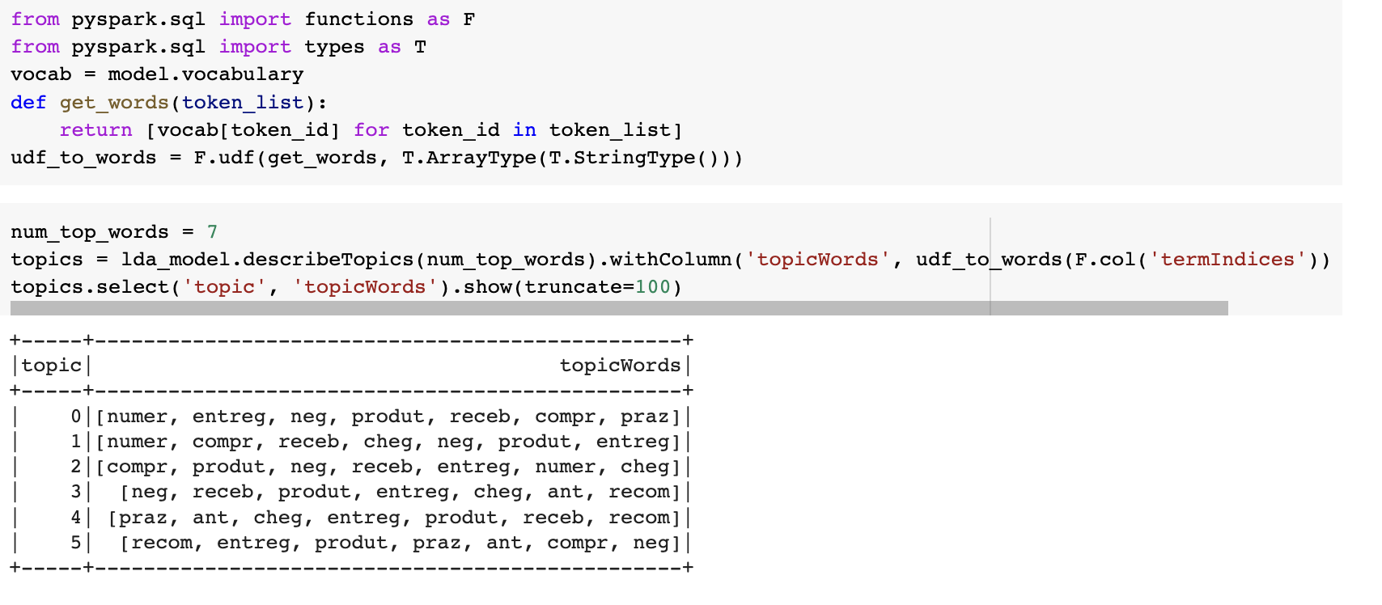
Topic Modeling
Define a function to extract the words.

Slide 13
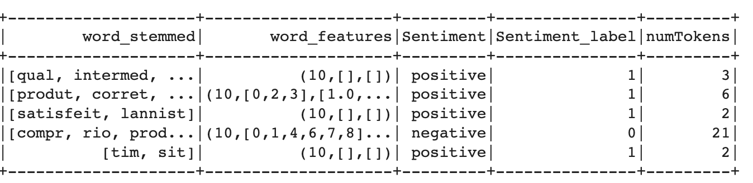
Text classification -Sentiment detection
Split class label to positive and negative
Positive scores 4-5
Negative scores 1-3

Slide 14
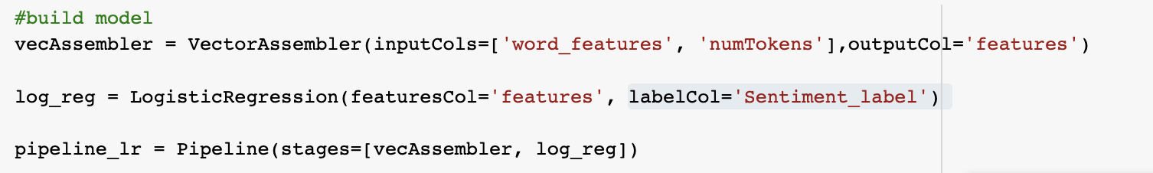
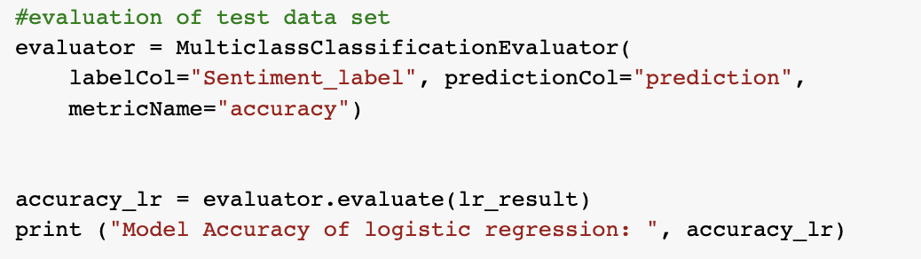
Text classification -Sentiment detection
Use pipeline and VectorAssembler to build the model
Use multiclassifactionevaluator to evaluate the model
Split train-test dataset to train models using:
Logistic regression Accuracy: 0.792
Decision tree Accuracy: 0.784
Random forest Accuracy: 0.796
Naïve bayes Accuracy: 0.783

Slide 15
Recommendation System
Using Spark Alternating Least Squares Algorithms with parameter tuning.

Slide 16
Retail Dataset Recommendation System
Using the Alternating least squares method in Spark to build a recommendation system with the existing master data frame.
2 Approaches have been taken. In the first approach, we took the user_id, product_id, review_score columns to build a recommendation system.
I have used the rank of the product based on the count of their sales and generated unique product_id and similarly customer_id for each of the customers and products.
The results produced an RMSE of 4.32 which is very high.

Slide 17
Clustering Methods to Improve the predictions.
In order to reduce the RMSE and improve the predictions, a few transformations are made to the master data frame in order to create 2 new data frames (items_features, items_features_clustered).
items_features_clustered dataset is created using K means clustering method.
An improved RMSE score can be observed with an RMSE value of 0.595.

Slide 18
References:
ref: https://medium.com/trustyou-engineering/topic-modelling-with-pyspark-and-spark-nlp-a99d063f1a6e
https://github.com/maobedkova/TopicModelling_PySpark_SparkNLP/blob/master/Topic_Modelling_with_PySpark_and_Spark_NLP.ipynb
https://blog.csdn.net/silentwolfyh/article/details/103492419

Slide 19
Thank you

